Slide 1

Introduction to using nsible with vSphere
Notes:
Make this work for small shops and big shops
Tie it back to business outcomes

Slide 2


Slide 3

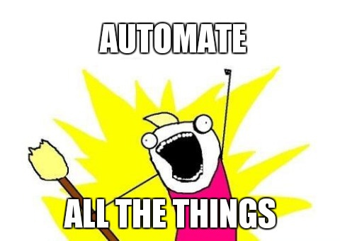


Bio
@carlcapozza
https://github.com/carlcapozza
2018 vExpert
#PGHLittleHack
Notes:
QUESTION?
Who uses a configuration management system today?
How many of you are using Ansible?

Slide 4
Agenda
Configuration Management
Intro to Ansible
Tools to get started

Slide 5
Configuration Management
Why?
Environments need to be consistent
Protect yourself against the random change
Making an environment your own
Where will technology NOT help?
Determining what standards to implement
Notes:
Can mean different things to different people?
Just by itself it’s not a standard, you need organization buy in.
I target 80%
You can’t please everyone

Slide 6
Agenda
Configuration Management
Intro to Ansible
Tools to get started

Slide 7
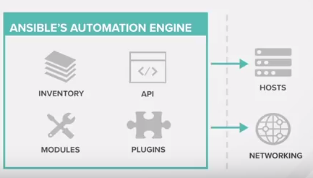
What is Ansible?
Notes:
Start with structure of the talk

Slide 8







Why Ansible for configuration management?
Linux with Ansible
No agents
Secure Shell (SSH)
Manage configuration of multiple infrastructure devices
Servers (Linux, AIX, Windows)
Networking (Routers, Switches, Load Balancers)
Hypervisors
YAML - Readability
Easy setup

Slide 9
Agenda
Configuration Management
Intro to Ansible
Tools to get started

Slide 10
Quick Installation
Management System
Install or select *nix system
Installing using Python Package Manager (PIP)
Install pip - $ sudo easy_install pip
Install ansible using pip - $ sudo pip install ansible
Install pyvmomi - $ sudo pip install pyvmomi

Slide 11
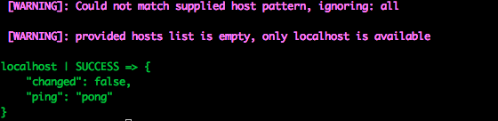
Does it work?
$ ansible –m ping localhost
http://bfy.tw/Hii1

Slide 12
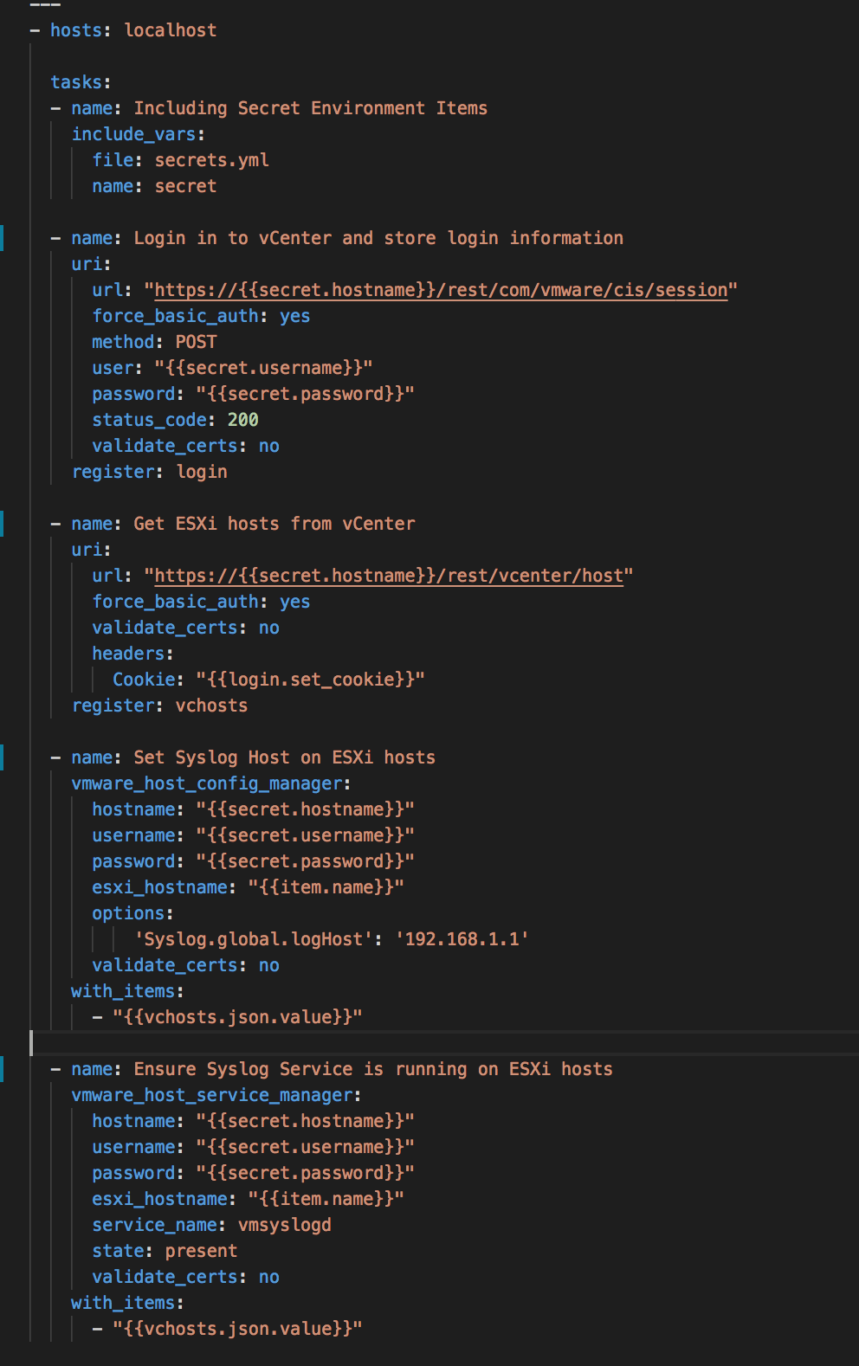
Example of using Ansible with vSphere
Research:
vSphere API
Write Code:
Tasks
Login
Get hosts
Set Syslog host
Ensure Syslog is running
Login
Get Hosts
Set Syslog
Ensure running

Slide 13
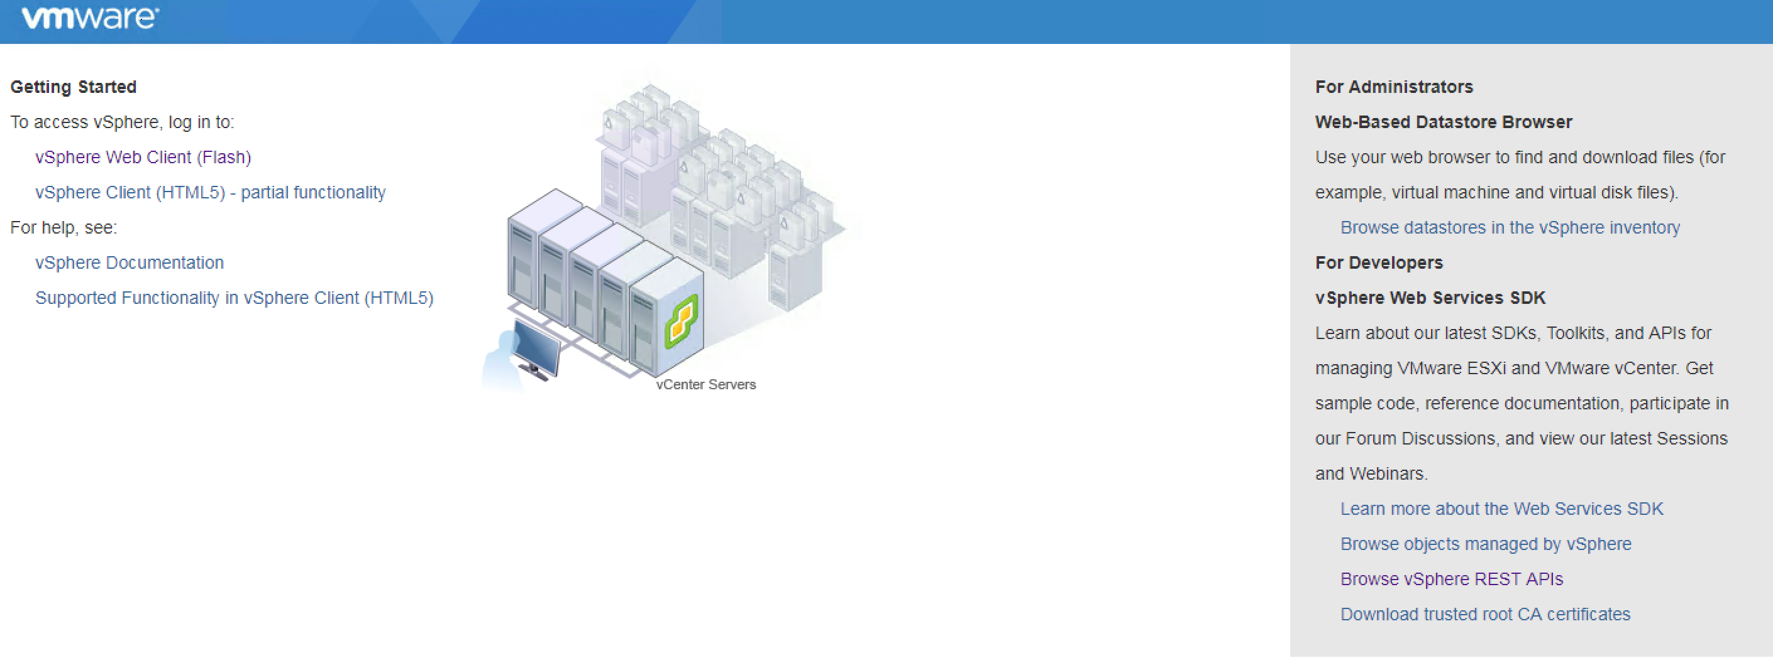
Accessing vCenter 6.5 API Explorer
https://[[VC IP Address or Hostname]]/apiexplorer
Browse vSphere REST APIs

Slide 14
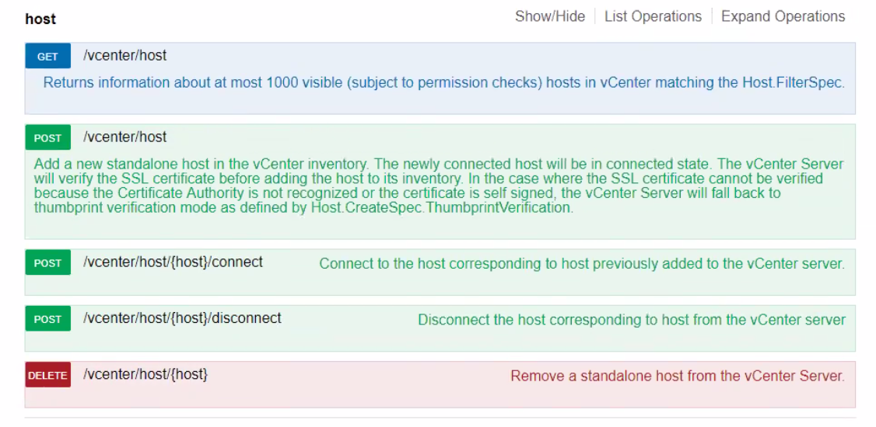
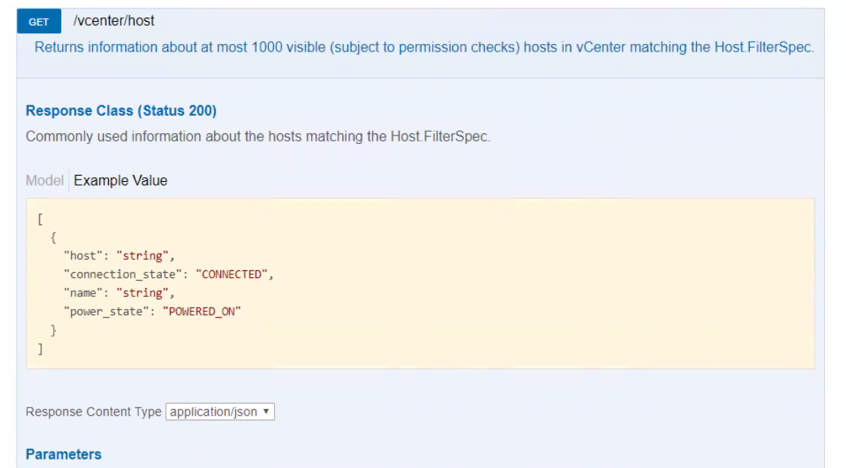
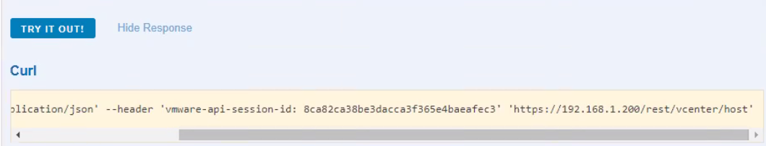
Find the Resource
Resource RESTful API
GET
POST
DELETE
GET host
Returns hosts in vcenter
TRY IT OUT!
https://[VC Server Name]/rest/vcenter/host

Slide 15

Example of using Ansible with vSphere
Research:
vSphere API
Write Code:
Tasks
Login
Get hosts
Set Syslog host
Ensure Syslog is running
Login
Get Hosts
Set Syslog
Ensure running

Slide 16
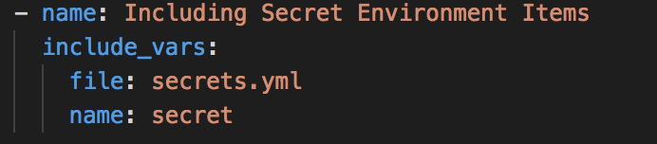
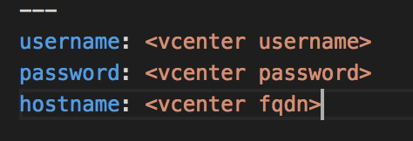
Login Credentials Management
Importing variables from a file
include_vars: (Module)
name: (Save these for later)
Secret File
Notes:
All of these are in the same file.

Slide 17
Example of using Ansible with vSphere
Research:
vSphere API
Write Code:
Tasks
Login
Get hosts
Set Syslog host
Ensure Syslog is running
Login
Get Hosts
Set Syslog
Ensure running

Slide 18
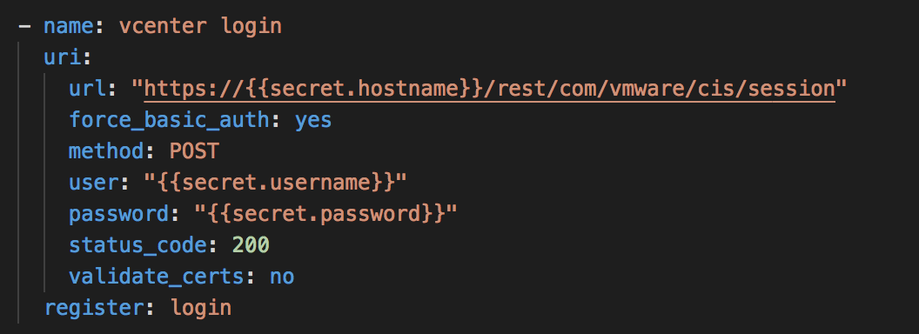
API Authentication
Ansible URI Module
hostname, user, and password are variables
register: (save the response information as login)

Slide 19
Example of using Ansible with vSphere
Research:
vSphere API
Write Code:
Tasks
Login
Get hosts
Set Syslog host
Ensure Syslog is running
Login
Get Hosts
Set Syslog
Ensure running

Slide 20
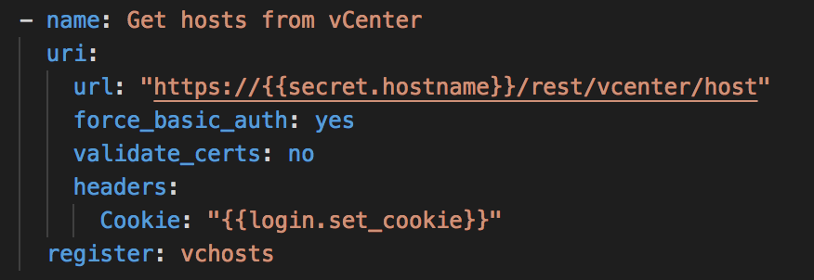
Get all the hosts in vCenter
Ansible URI module
JSON values returned

Slide 21
Example of using Ansible with vSphere
Research:
vSphere API
Write Code:
Tasks
Login
Get hosts
Set Syslog host
Ensure Syslog is running
Login
Get Hosts
Set Syslog
Ensure running

Slide 22
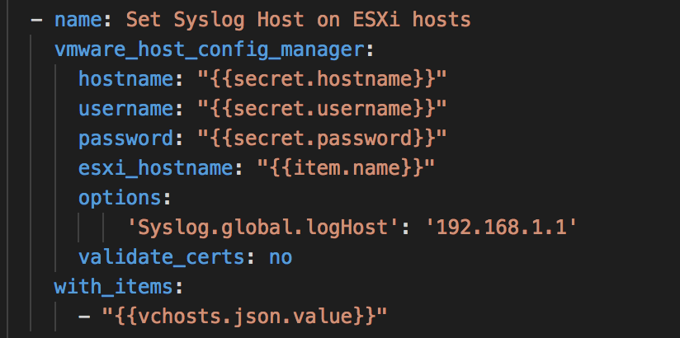
Set Syslog Host
Ansible Plugin (pyVmomi)
with_items: run the above on all values
{{item.name}} is variable containing each the esxi host name

Slide 23
Example of using Ansible with vSphere
Research:
vSphere API
Write Code:
Tasks
Login
Get hosts
Set Syslog
Ensure Syslog is running
Login
Get Hosts
Set Syslog
Ensure running

Slide 24
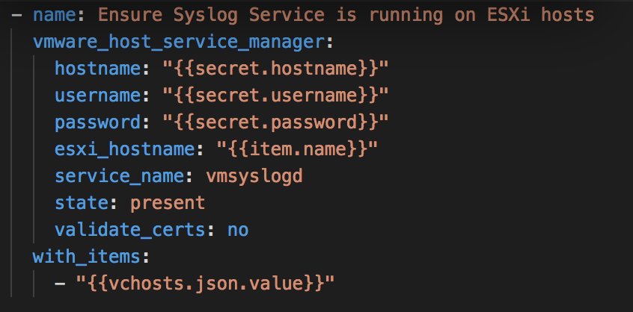
Ensure Syslog Service is running
Ansible Plugin (pyVmomi)

Slide 25
Example of using Ansible with vSphere
Research:
vSphere API
Write Code:
Tasks
Login
Get hosts
Set Syslog
Ensure Syslog is running
Login
Get Hosts
Set Syslog
Ensure running

Slide 26
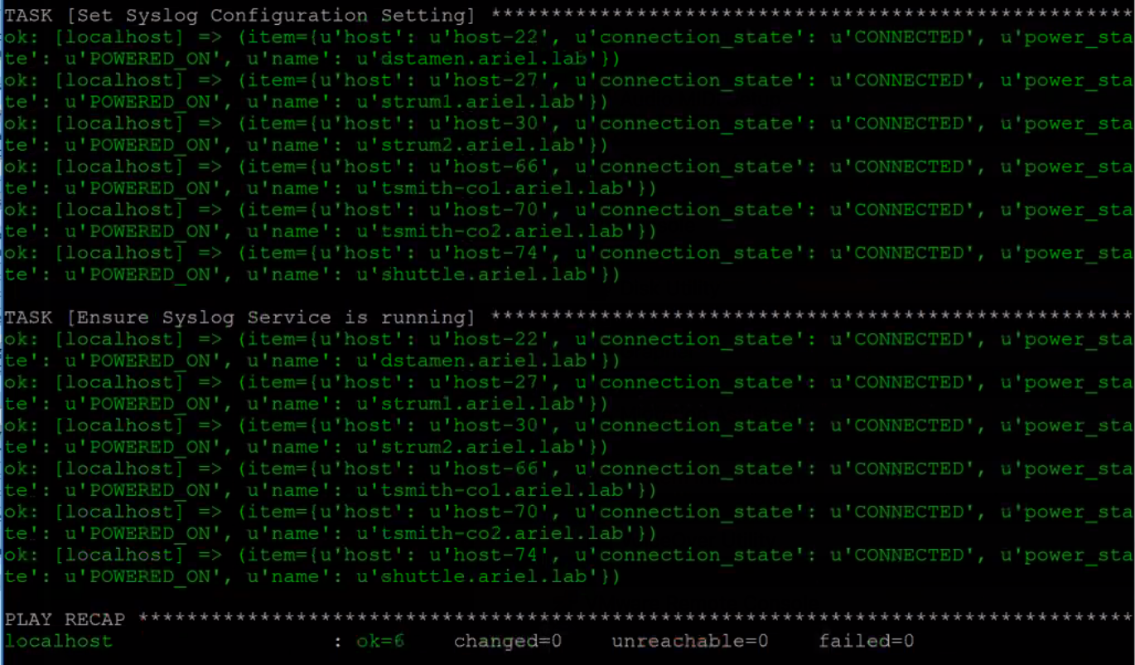
Run Playbook
Ansible-playbook get_host_api.yml

Slide 27

Agenda
Configuration Management
Intro to Ansible
Tools to get started

Slide 28
Further reading
Jonathan Frapier’s Blog
Everything Should Be Virtual
Kyle Ruddy’s vBrownBag on vSphere 6.5 REST APIs
vmware ansible modules
Ansible Documentation

Slide 29
#PGHLittleHack
2nd Monday of the Month
Follow the #PGHLittleHack on Twitter

Slide 30
Questions?

Slide 31
Photo Links
Ansible All The Things
Ansible and DataDog Because Life is Short
Ansible & Automation So Hot Right Now

